Slide 1


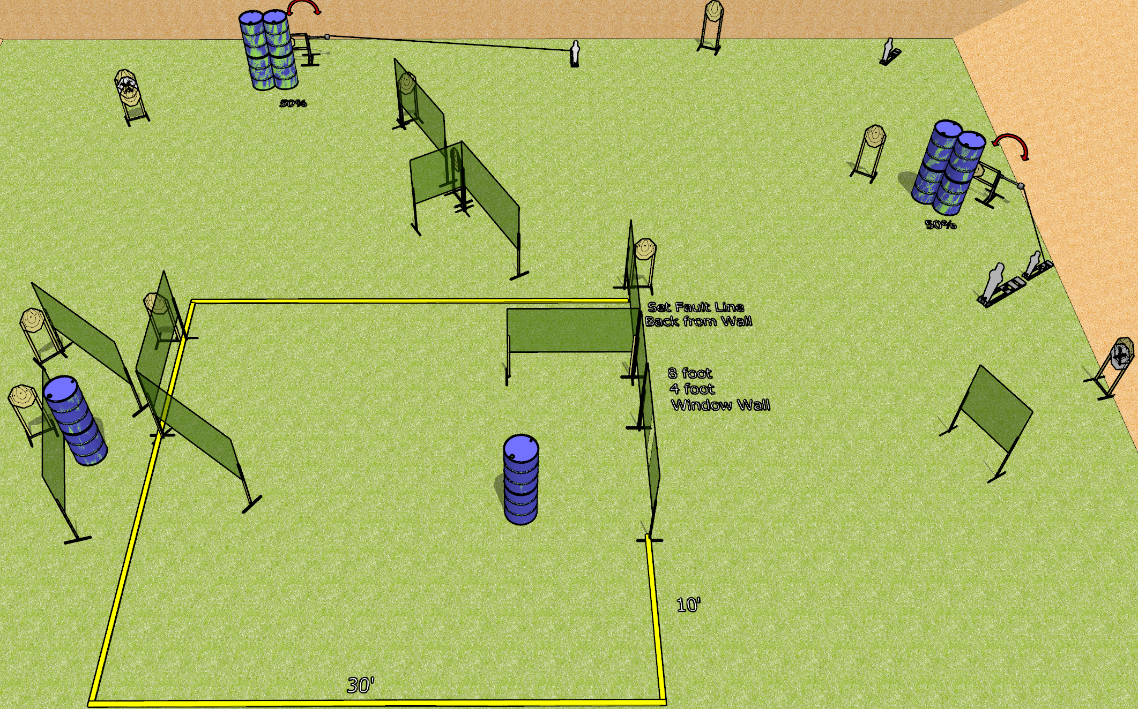
 | Dothan Gun Club – USPSA Match Gone Crazy Course Designer : Drew Coleman
Round Count 30 rounds 13 IPSC 3 mini poppers, 1 pepper popper
Equipment List 2 swingers + activators 21 wall feet 1 tuxedo, 2 50% (on swingers)

Slide 2
Gone Crazy
Written Stage Briefing
Gone Crazy is a 30 round, 150 point, Comstock course of fire. There are 13 IPSC targets, 3 mini poppers, and 1 pepper popper. The best 2 hits on paper will score, and steel must fall to score. The start signal is audible.
Left swinger is activated by the mini popper closest to it. Right swinger is activated by the mini popper behind the pepper popper. Both swingers are visible at rest.
Handgun start position is toes touching the frontmost fault line, wrists below belt. Handgun is loaded and holstered.
PCC start position is toes touching the frontmost fault line, stock on belt. Loaded carbine is held with both hands safety on.
On start signal engage the targets as they become available from within the shooting area.

